Slide 1
An Introduction to
Unified Modelling Language (UML)

Slide 2
UML Basics
What is UML? – It is a general purpose visual modelling language that is used to specify, visualize, construct, and document the artefacts of a software system.
UML captures information about the static structure and dynamic behaviour of a system.
Static structure defines the objects and its implementations
Dynamic behaviour defines the history of objects and the communications among object to accomplish goals.

Slide 3
The Triangle of Success
Notations
Processes
Tools

Slide 4
Purpose of UML
Provide users with a ready-to-use, expressive visual modeling language so they can develop and exchange meaningful models.
Provide extensibility and specialization mechanisms to extend the core concepts.
Be independent of particular programming languages and development processes.
Provide a formal basis for understanding the modeling language.
Encourage the growth of the OO tools market.
Support higher-level development concepts such as collaborations, frameworks, patterns and components.
Integrate best practices.

Slide 5
Why UML
To automate the production of software and
To improve quality and reduce cost and time-to-market.
To adopt best/better techniques include component technology, visual programming, patterns and frameworks.
To manage the complexity of systems as they increase in scope and scale.

Slide 6
Types of UML Diagrams
Use case diagram: displays the relationship among actors and use cases.
Class diagram: models class structure and contents using design elements such as classes, packages and objects. It also displays relationships such as containment, inheritance, associations and others.
Sequence diagram displays the time sequence of the objects participating in the interaction. This consists of the vertical dimension (time) and horizontal dimension (different objects).
Collaboration diagram displays an interaction organized around the objects and their links to one another. Numbers are used to show the sequence of messages.
State diagram: displays the sequences of states that an object of an interaction goes through during its life in response to received stimuli, together with its responses and actions.
Activity diagram: displays a special state diagram where most of the states are action states and most of the transitions are triggered by completion of the actions in the source states. This diagram focuses on flows driven by internal processing.
Component Diagram: displays the high level packaged structure of the code itself. Dependencies among components are shown, including source code components, binary code components, and executable components. Some components exist at compile time, at link time, at run times well as at more than one time.
Deployment Diagram: displays the configuration of run-time processing elements and the software components, processes, and objects that live on them. Software component instances represent run-time manifestations of code units.

Slide 7
Use Case
What is an use case? - A use case is a set of scenarios that describing an interaction between a user and a system.
When to Use: Use Cases Diagrams? - Use cases are used in almost every project. The are helpful in exposing requirements and planning the project. During the initial stage of a project most use cases should be defined, but as the project continues more might become visible.

Slide 8
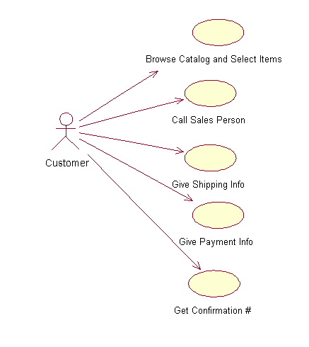
Use Case Example
Start by listing a sequence of steps a user might take in order to complete an action.
For example a user placing an order with a sales company
might follow these steps.
.

Slide 9
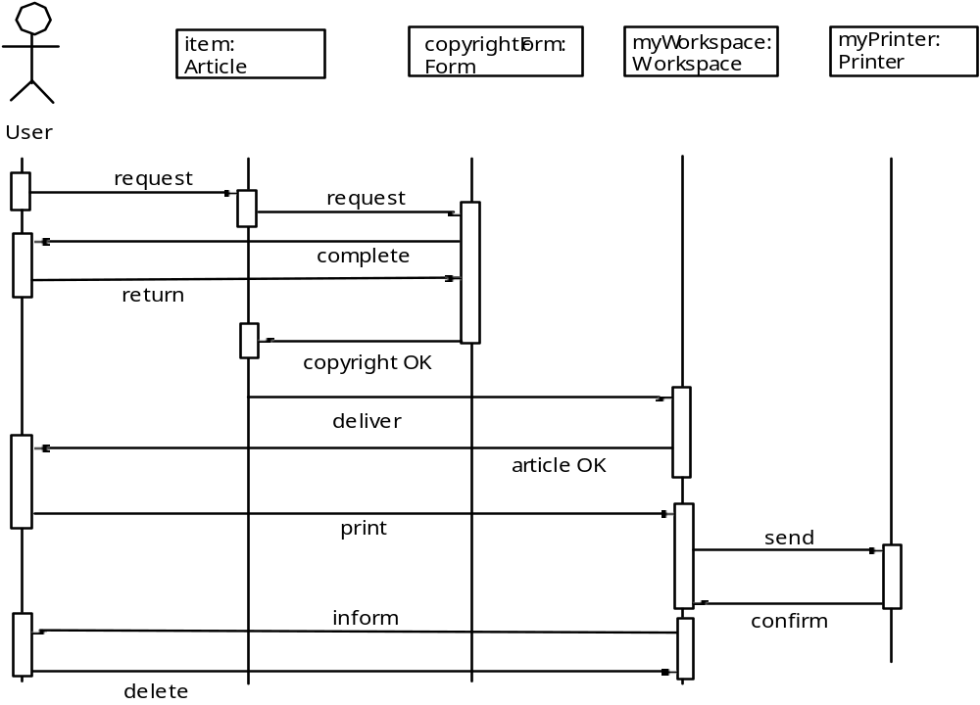
Sequence Diagram

Slide 10
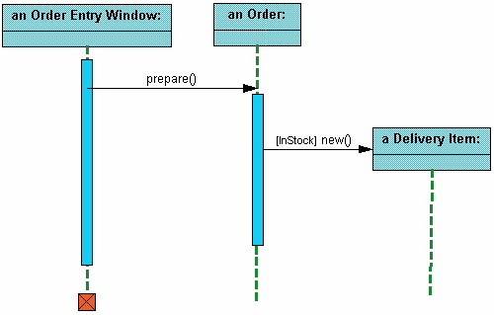
Interaction Diagrams
Sequence diagrams demonstrate the behaviour of objects in a use case
by describing the objects and the messages they pass.

Slide 11
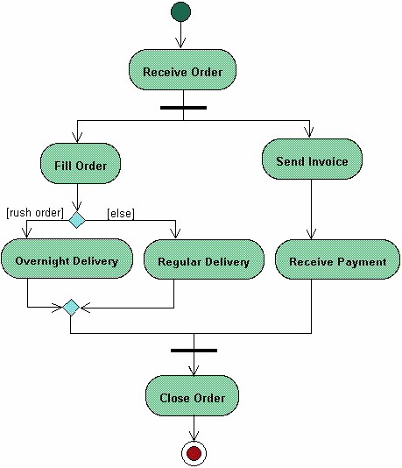
Activity Diagrams
Activity diagrams describe the workflow behavior of a system.
Activity diagrams show the flow of activities through the system.

Slide 12
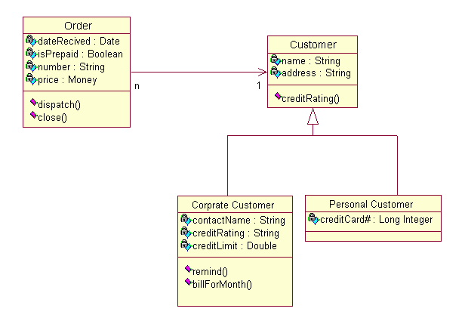
Class Diagram
Class diagrams are widely
used to describe the types
of objects in a system and
their relationships.
Classes are composed of three things: a name, attributes, and operations.

Slide 13
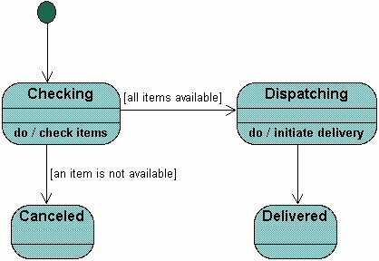
State Diagrams
State diagrams are used to describe the behavior of a system. State diagrams describe all of the possible states of an object as events occur.

Slide 14
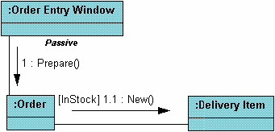
Collaboration Diagrams
Collaboration diagrams show the relationship between objects and the order of messages passed between them.

Slide 15
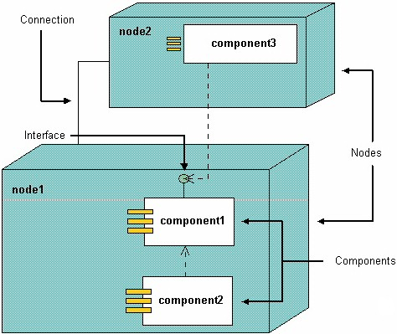
Physical Diagrams
There are two types of physical diagrams: deployment diagrams and component diagrams.
Deployment diagrams show the physical relationship between hardware and software in a system.
Component diagrams show the software components of a system and how they are related to each other.

Slide 16
A List of UML Software
Rational Rose - http://www.developers.net/ibmshowcase/view/249
Visual Paradigm
http://www.visual-paradigm.com/download/vpuml.jsp?edition=ce

Slide 17
Reference
David Braun et al. “UML Tutorial.” http://atlas.kennesaw.edu/~dbraun/csis4650/A&D/UML_tutorial/index.htm
Randy Miller, “PRACTICAL UML: A HANDS-ON INTRODUCTION FOR DEVELOPERS” http://dn.codegear.com/article/31863#use-case-diagram
Object Management Group – UML http://www.omg.org/gettingstarted/what_is_uml.htm

